Slide 1
Rectal prolapse
By:
Ibrahim Falih Noori

Slide 2
Rectal prolapse
It is circumferential descent of rectum through the anal canal
It is commonly seen in infants, children, and elderly individuals.
It is more common in female ( 6:1)

Slide 3
Pathophysiology
There are two main theories, which essentially are different ways of expressing the same idea.
The first theory postulates that rectal prolapse is a sliding hernia through a defect in the pelvic fascia.
The second theory holds that rectal prolapse starts as a circumferential internal intussusception of the rectum beginning 6-8 cm proximal to the anal verge. With time and straining, this progresses to full-thickness rectal prolapse, though some patients never progress beyond this stage.

Slide 4
The pathophysiology and etiology of mucosal prolapse most likely differ from those of full-thickness rectal prolapse and internal intussusception
Mucosal prolapse occurs when the connective tissue attachments of the rectal mucosa are loosened and stretched, thus allowing the tissue to prolapse through the anus. This often occurs as a continuation of long-standing hemorrhoidal diseases and is treated as such.

Slide 5
Etiology
Decreased sacral curvature and decreased anal canal tone are probable cause s in children
Diarrhea Cough, malnutrition are additional factors in children.
It may be due to reduced ischiorectal fossa fat , neurological causes, fibrocystic diseases of pancreas or poorly developed pelvis.
In adults, it is common in in females, common in multipara- repeated birth injuries to perineum results in damage to perineal nerve supply.
It could results due to weakening of supporting tissue and levator ani muscles, atony of sphincters, increased intra abdominal pressure due to any cause like chronic cough , constipation, and difficult micturition

Slide 6
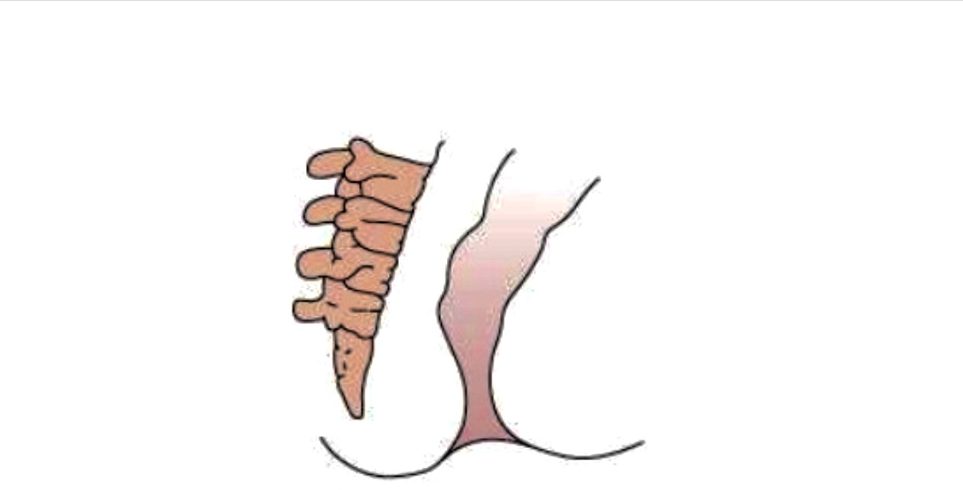
The absence of the normal curve predispose to rectal prolapse in an infant

Slide 7
Three different clinical entities are often combined under the umbrella term rectal prolapse:
Partial or Mucosal prolapse
Full-thickness rectal prolapse
Internal prolapse (internal intussusception)

Slide 8
1-Partial or mucosal rectal prolapse
partial propose: here only the mucosa and submucosa of the rectum descend, not more than 4 cm,. There is no descent of the muscular layer,
It is the commonest type of rectal prolapse.

Slide 9
Clinical features of partial rectal prolapse.
History of mass per anum, which is can be observed when the child is allowed to strain in squatting position
It is pink in color and circumferential.
It differs from piles (differential diagnosis) , the piles are not circumferential and are plum or blue colored (not pink)

Slide 10
Partial rectal prolapse

Slide 11
Differences between partial rectal prolapse and piles
Partial rectal prolapse
Piles

Slide 12
Treatment of partial prolapse
The nutrition of the child should be improved and digital repositioning is tried
Submucosal injections of 10ml of 5% phenol in almond oil or ethanolamine oleate is given into the apex of the prolapse under G/A so as to create aseptic inflammation leading to the tethering of mucosa to the underlying muscular coat . Injections can also be given at the base or both at the apex and the base.
Thiersh wiring is tried with variable success rate in children.
Goodsall’s operation : is excision of the prolapsed mucosa at its base m usually three position

Slide 13
Theirsh operation
Goodsall’s operation

Slide 14
Complete or full thickness rectal prolapse
Also called procidentia, is less common than partial prolapse.
It is common in females ( 6:1 female : male ratio).
It is due to weakened levator ani supporting pelvic tissues.
The descent is always more than 4 cm, contains all layers of the rectum. Often descends down up to 10 -15 cm .
It is often associated with uterine prolapse.
Patulous anal sphincter is typical with mucous discharge and faecal incontinence.
It is thought to be as an intussusception of the rectum

Slide 15
Aetiological factors
Weak anus, external sphincter and pelvic muscles
Lax, mobile rectum.
Obliterated ano-rectal angle.

Slide 16
Clinical features of complete rectal prolapse
Complete descent of the rectum which is red in color and often painful, as mass per anum.
Faecal incontinence is very common . It is due to disruption of the anal sphincter and prolapsed rectal mucosal discharge.
Pain per anum
Bleeding can occur because of congestion .
Sepsis , discharge Fever, anaemia are other features.
DRE examination shows lax sphincter. Anteriorly peritoneal sac comes down as a pouch which may contain small bowel.
Solitary rectal ulcer in 10- 25 % of cases.

Slide 17
Complete rectal prolapse. It is more than 4 cm and mucosal and muscular layers

Slide 18
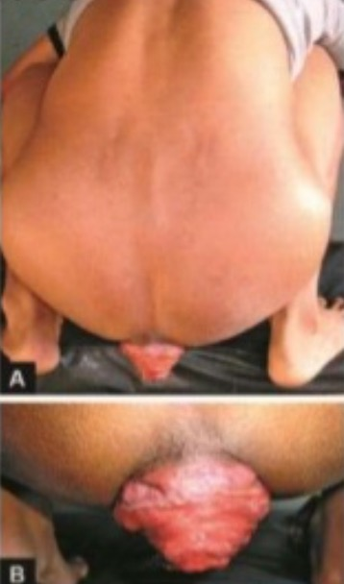
Complete rectal prolapse observed in squatting position

Slide 19
Rectal prolapse
Partial thickness rectal prolapse
Full thickness rectal prolapse

Slide 20
Investigations
Laboratory studies
There are no specific tests that aid in the evaluation of rectal prolapse itself.
sweat chloride test for pediatric patients; as many as 11% of children with rectal prolapse have cystic fibrosis.
stool examination and culture for infectious agents, particularly in pediatric patients.
II. Barium enema and colonoscopy.
III Video defecography
IV Rigid proctosigmoidoscopy.
V Ano-rectal manometry.
VI pudendal nerve terminal motor latency.

Slide 21
Defecographic grading of rectal prolapse
N- Normal rectal fixation and sphincter relaxation and rectal emptying .
1- Nonrelaxed puborectalis .
2- Mild intussusception .
3- Moderate intussusception.
4- Sever intussusception.
5- Prolapse.
R- Rectocele

Slide 22
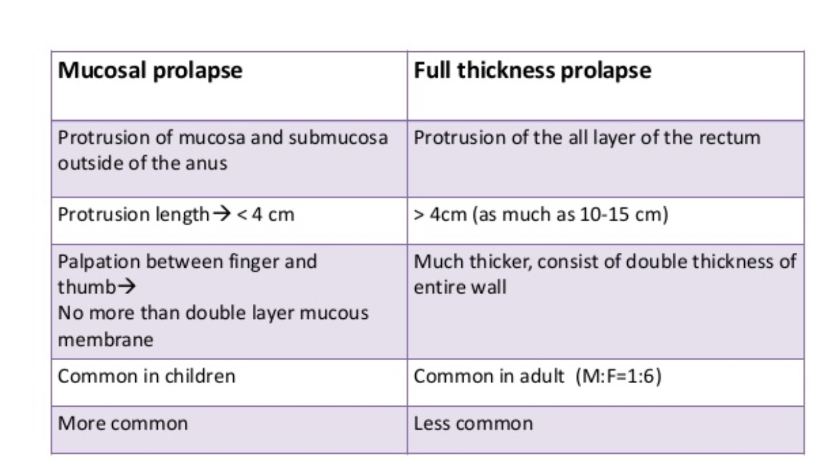

Slide 23
Complications of full thickness rectal prolapse
Ulceration
Strangulation
Fecal and urinary incontinence
Spontaneous rupture and eviseration.

Slide 26
Treatment of full thickness
Non operative management:
Generally, a prolapsed rectum can be reduced with gentle digital pressure; an incarcerated rectal prolapse is rare.
Although no medical treatment is available for rectal prolapse, internal prolapse should always be first treated medically with bulking agents, stool softeners, and suppositories or enemas.
Biofeedback may be helpful if paradoxical pelvic floor contraction also exists.
Contributing factors, such as constipation and diarrhea, should be addressed and eliminated if possible.

Slide 27
Surgical treatment
The aims of surgical treatment are to control the prolapse, , to restore continence, and to prevent constipation
Surgical treatments can be divided into two categories according to the approach used to repair the rectal prolapse: abdominal procedures and perineal procedures.
The choice between an abdominal procedure and a perineal procedure is mainly dictated by the patient’s age and comorbidities.
the abdominal procedures have a lower recurrence rate but a higher morbidity.

Slide 28
Accordingly, older, debilitated patients (whose life expectancy is shorter) are generally treated with perineal procedures, whereas younger, healthier patients are typically treated with abdominal procedures.
In young male, abdominal repairs carry a risk of injury to pelvic nerve leading to sexual impotence. So perineal approach is better.
Surgical therapy for internal prolapse is usually avoided because results are poor, with durable relief of symptoms occurring in fewer than 50% of patients.

Slide 29
Abdominal procedures
abdominal repairs are typically performed in younger, healthier patients, whose life expectancy is longer.
The choice of abdominal procedure is often dictated by the extent of the associated constipation and by the surgeon’s preference, The main abdominal procedures include:
Anterior resection: Patients with rectal prolapse and constipation often have a redundant colon, and some surgeons believe that resection of this alleviates constipation and decreases recurrence of rectal prolapse.

Slide 30
Marlex rectopexy: In a Marlex rectopexy (Ripstein procedure), the entire rectum is mobilized down to the coccyx posteriorly, the lateral ligaments laterally, and the anterior cul-de-sac anteriorly. A nonabsorbable material (eg, Marlex mesh is fixed to the presacral fascia. The rectum is placed on tension, and the material is partially wrapped around the rectum to keep it in position.
Suture rectopexy: A suture rectopexy is essentially the same as a Marlex rectopexy, except that the rectum is fixed to the presacral fascia with suture material rather than mesh or an Ivalon sponge.
Resection rectopexy: A resection with rectopexy (Frykman-Goldberg procedure) is a combination of an anterior resection and a Marlex rectopexy;

Slide 31
Perineal procedures
Perineal procedures have higher recurrence rates but lower morbidities and are often performed in elderly persons or in patients for whom general anesthesia is contraindicated. They include:
Anal encirclement ( Theirsh procedure): nonabsorbable band is placed subcutaneously around the anus. The purpose of this procedure is to keep the rectum from prolapsing by restricting the size of the anal lumen. Although the procedure was initially described as using a wire, it now employs other materials (eg, Silastic tubing and nonabsorbable suture material) instead. Anal encirclement is effective in mechanically preventing the rectum from prolapsing, but it does not treat the underlying disorder.

Slide 32
Delorme mucosal sleeve resection: a circumferential incision is made through the mucosa of the prolapsed rectum near the dentate line; with the electrocautery, the mucosa is stripped from the rectum to the apex of the prolapse and excised. The denuded prolapsed muscle is then pleated with a suture and reefed up like an accordion, and the transected edges of the mucosa are sutured together.
Altemeier perineal rectosigmoidectomy: a full-thickness circumferential incision is made in the prolapsed rectum about 1-2 cm from the dentate line . The hernia sac is entered, and the prolapse is delivered. The mesentery of the prolapsed bowel is serially ligated until no further redundant bowel can be pulled down. The bowel is transected and either hand-sewn to the distal anal canal or stapled with a circular stapler
Perineal stapled prolapse resection

Slide 35
Solitary rectal ulcer

Slide 37
Solitary rectal ulcer

